Slide 1


E-Pariksha
Presented by
1) Pritam Kadam
2) Abhijit Mutkule
3) Chandrakant Padme
4) Pooja Patil
5)Sagar Thorat
6)Sumit Bonde

Slide 2
E-Pariksha is an online examination portal, whose main objective is to provide platform where students can login and can give online exam easily with instant result. It provides an efficient platform for both teachers and students & also it helps us to provide hassle-free and paperless exam which leads to reduce in cost and environment-friendly approach. E-Pariksha contains following core functions: 1) Landing page : It contains portal information with 3 login for admin, teacher, student. 2)Admin Dashboard 3)Teacher Dashboard 4)Student Dashboard Below usecase shows the flow of the project and all sub-features of dashboards

Slide 3
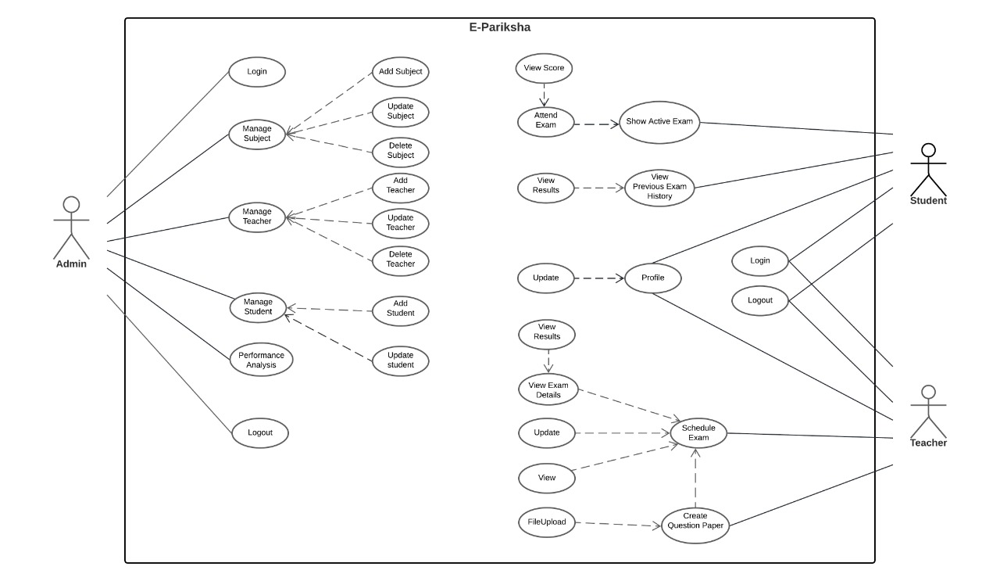
Use Case

Slide 4
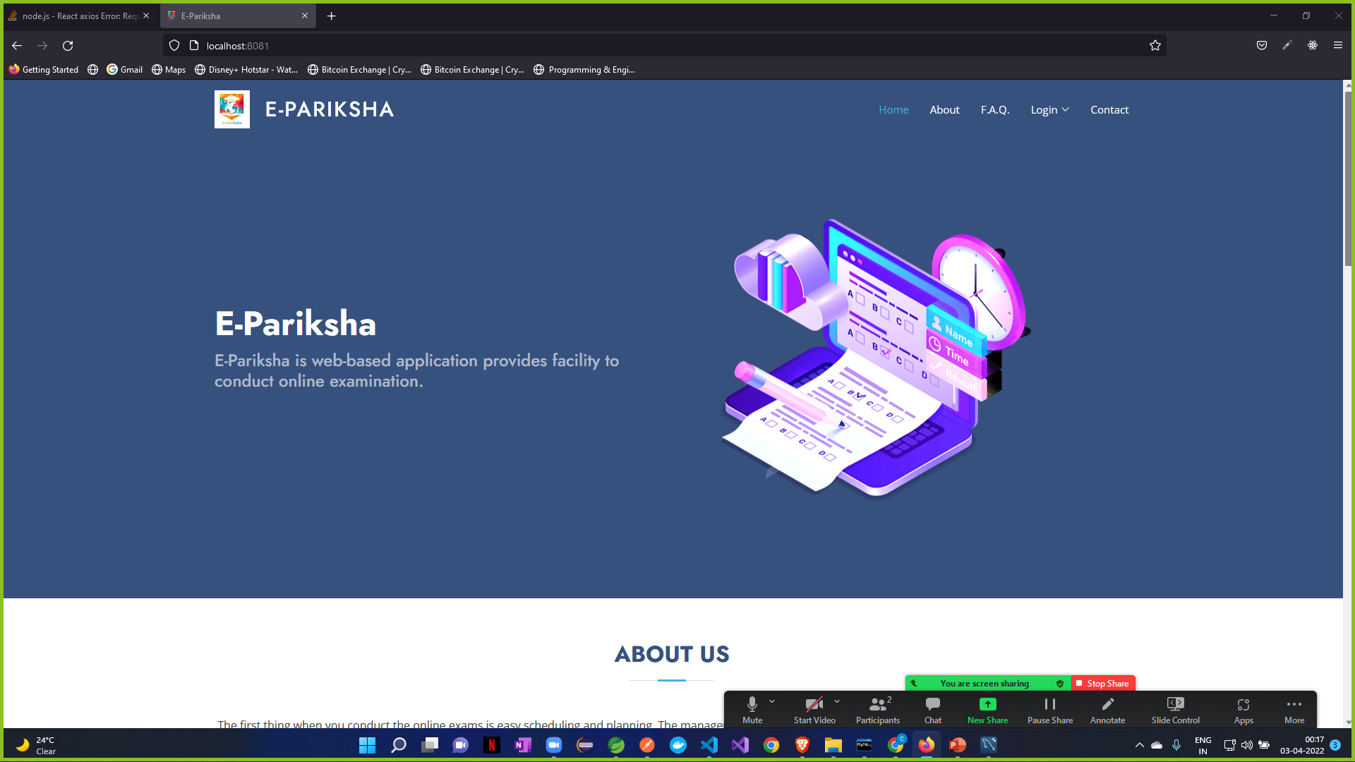
Website Landing Page

Slide 5
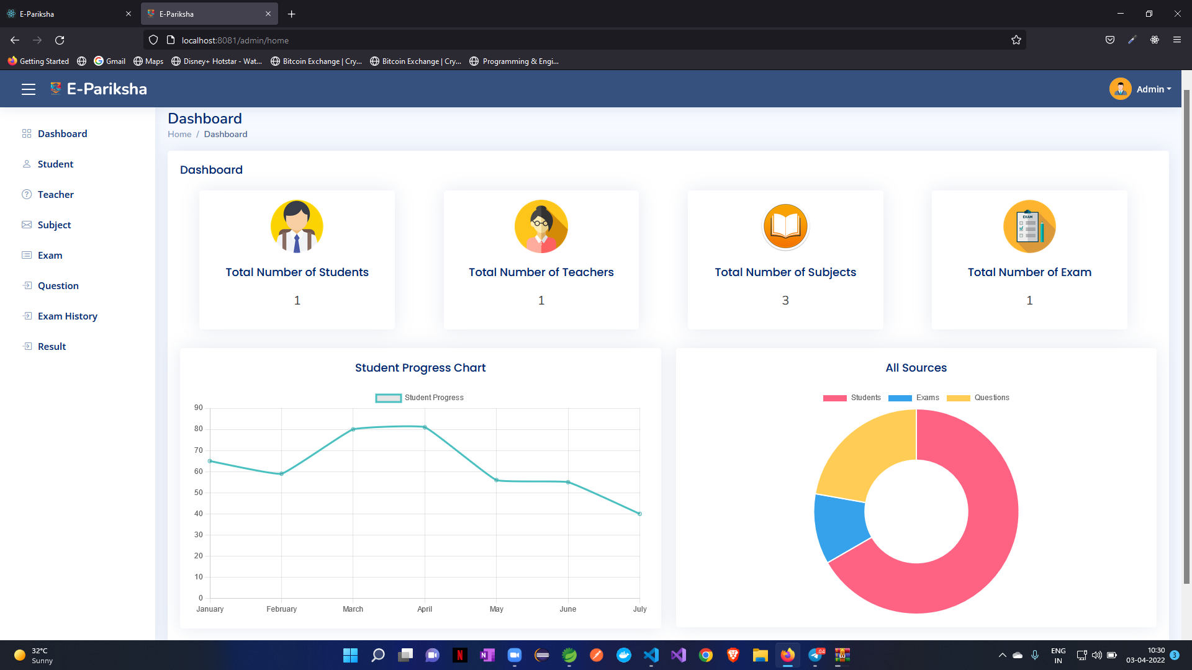
Admin Dashboard
Admin Module:
Admin module contains admin login/register page. After, login admin has dashboard containing options such like add/update Students, Teachers and Subjects. Admin Module has its own profile information with update option and logout option.

Slide 6
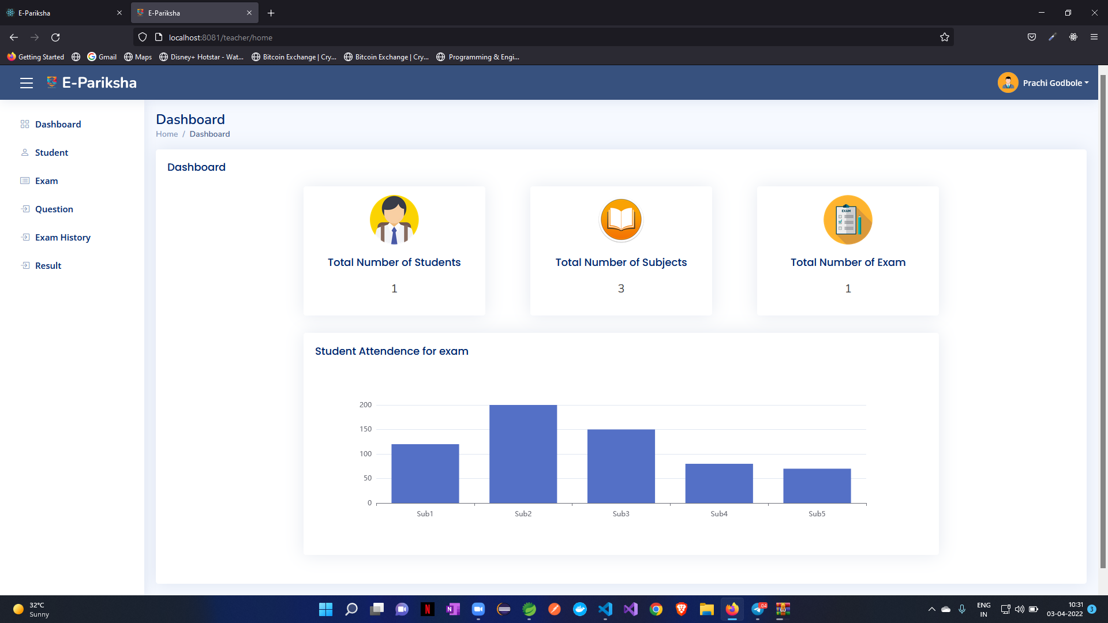
Teacher Dashboard
Teacher Module:
Teacher module contains login/register page. After, login Teacher has dashboard containing options such like add/update questions to test, view questions, schedule exam, profile information of teacher with update option and logout.

Slide 7
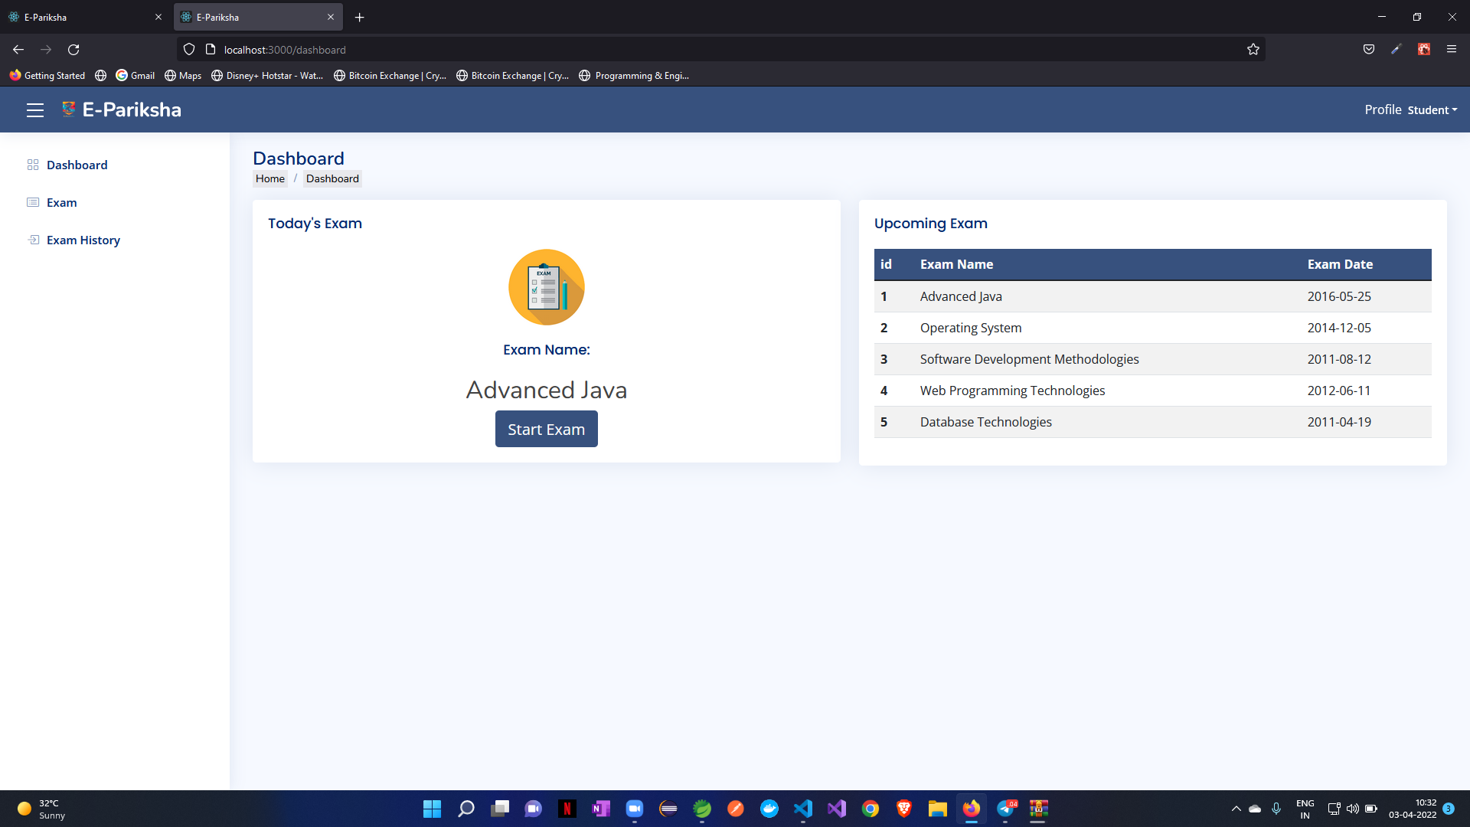
Student Dashboard
Student Module:
Student module contains student login/register page. After, login Student has dashboard containing options such like attend exam and view score, profile information with update, view previous test result history, feedback, logout.

Slide 8
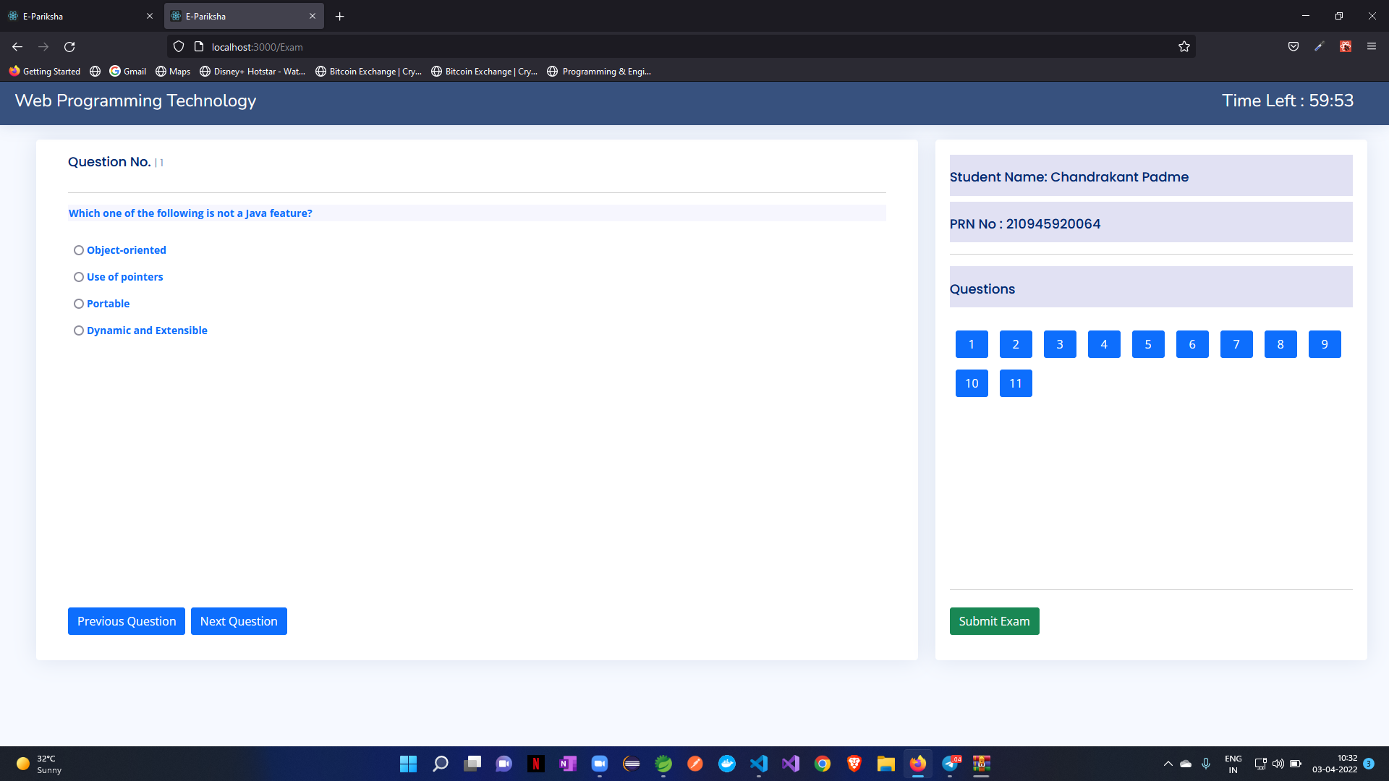
Exam

Slide 9
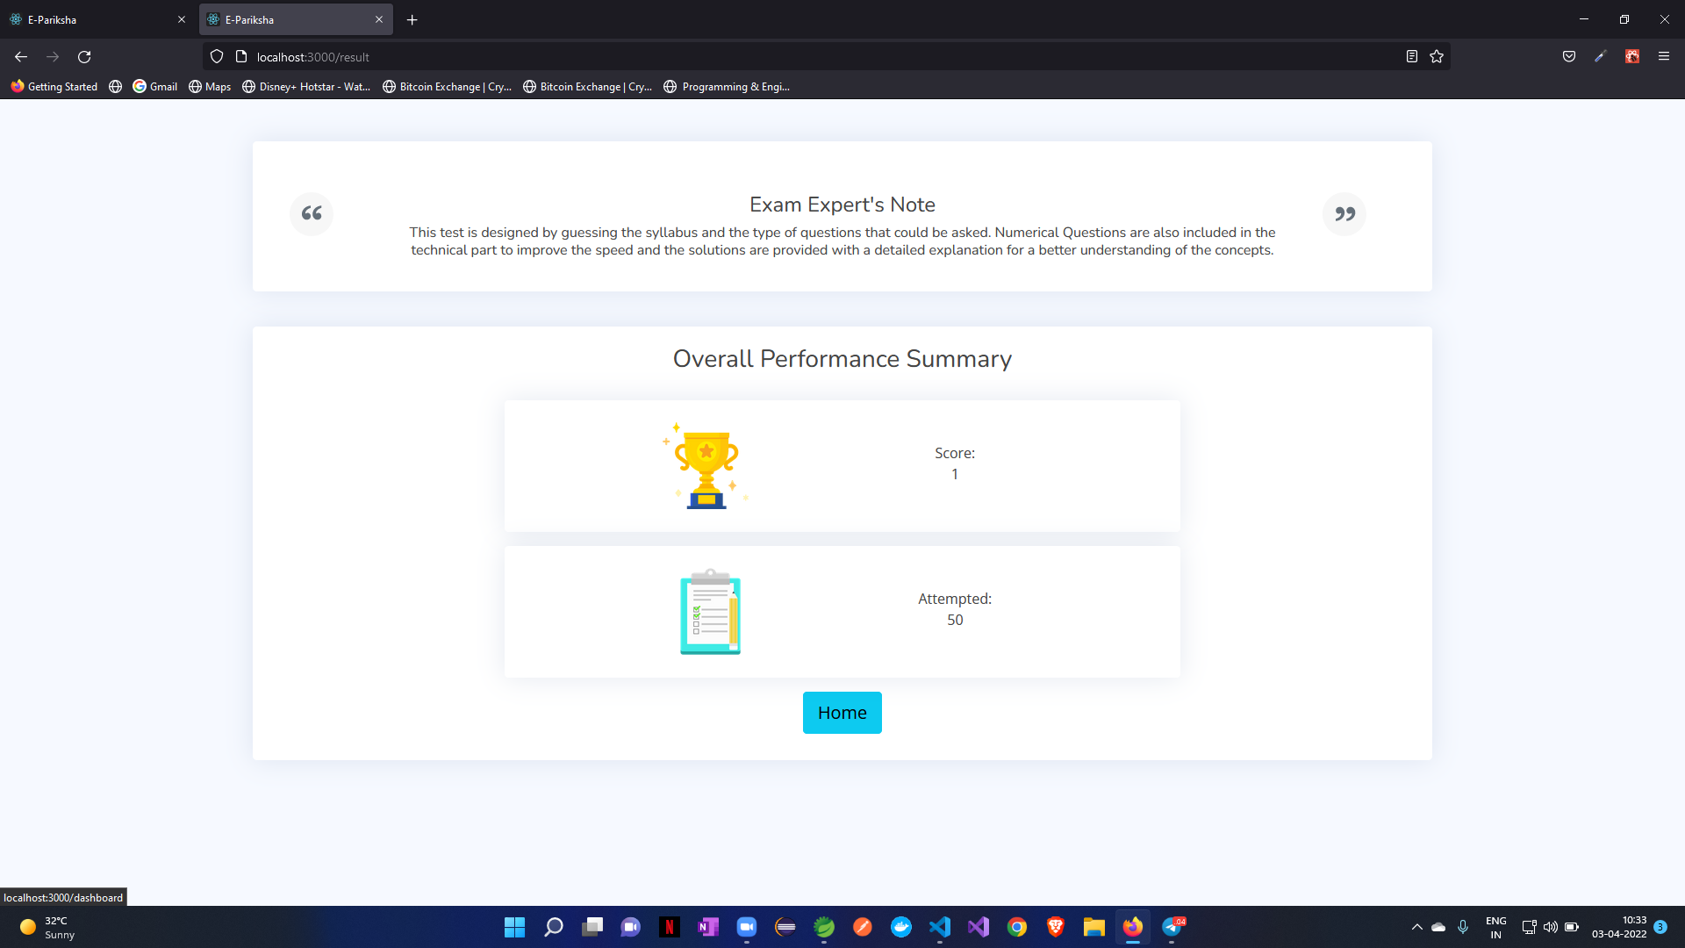
Result

Slide 10
Thank You

